Slide 1
W10D1
Recommender Engines I
Instructor: Jeremy Eng
Credit: Eric Elmoznino
Notes:
Just finished some really new and hard topics (deep learning, computer vision, NLP, time series). How do you feel?
Set of algorithms for determining what you might like.
Fun lecture. Almost no new technical concepts. Using existing concepts in a new context.

Slide 2
Outline for today
Overview
Content-based vs. collaborative
Content-based recommender
Step 1: Define item features
Step 2: Define a distance metric
Step 3: Recommend similar items
Activity: movie feature engineering
Case study: co-occurrence feature engineering
Demo
Notes:
Content-based today, collaborative tomorrow

Slide 3
Overview

Slide 4
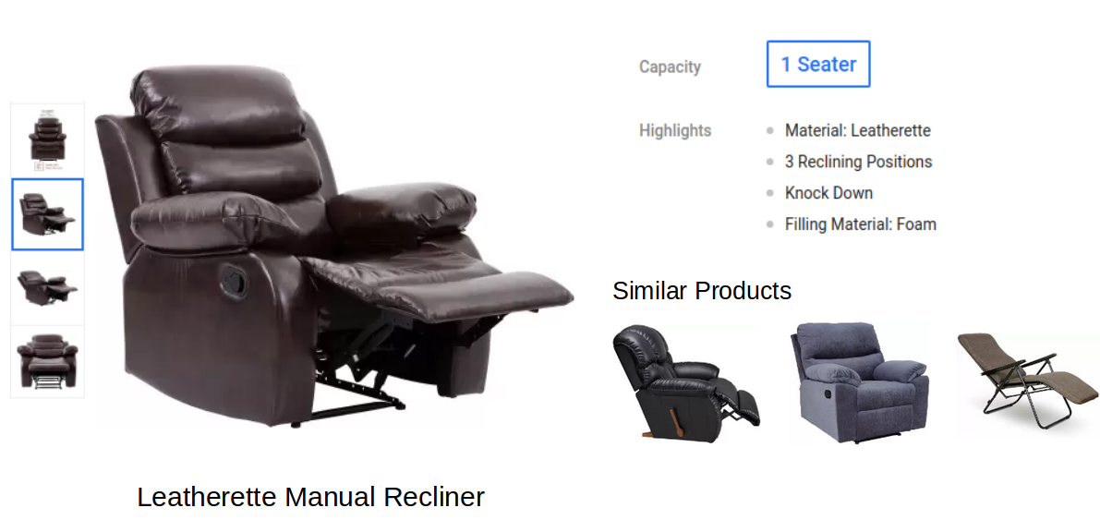
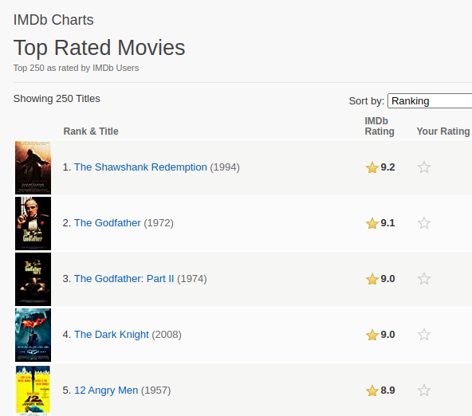
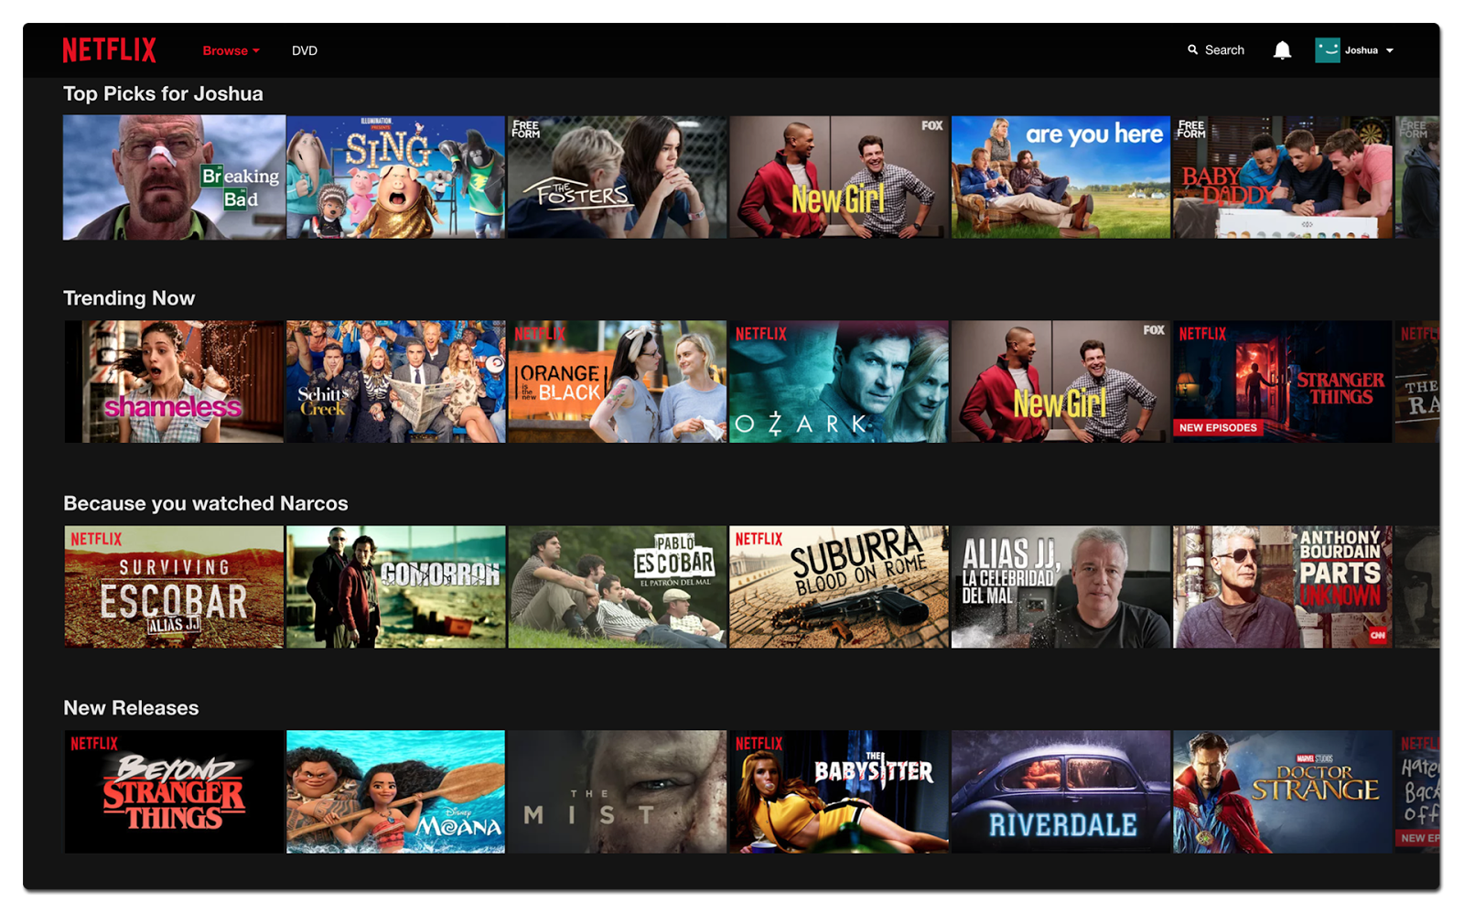
Examples
Notes:
Can make simple recommendations based on what’s popular. IMDB movie popularity. However, not personalized and we’re going to try doing better using machine learning tools rather than just statistics.
How can we recommend items that are similar to something a person is interested in? Main topic of today’s lecture.
Tomorrow’s lecture: how can we recommend an item that a person is likely to be interested in based on their similarities to other users?
Type of algorithm that won a $1M prize from Netflix.

Slide 5
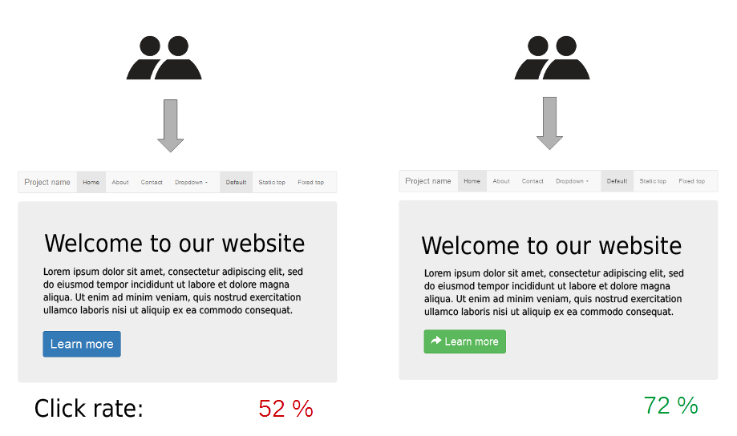
Recommender engines
Users: purchaser of Amazon products, Netflix binge-watcher, social media subscriber, etc.
Items: Amazon products, Netflix shows, social media posts, etc.
Goal: optimize some business (e.g. clicks, longer screen time, revenue, conversion rate)
Algorithms will often be compared to baselines and alternatives using A/B experiments
Notes:
A/B testing – randomly split customers into two groups that see different versions of a website (for example). Compare statistics.
Similarly to how Facebook rolls out fast updates to subsets of the user base to evaluate them, recommender engines will often be used on subsets of the customer base until they’ve been shown to be successful (randomized controlled trial).

Slide 6
Content-based vs. collaborative

Slide 7
Content-based vs. collaborative
Content-based recommender: use knowledge of each item to recommend a similar one (item-based recommendation)
Example: customer looking at a computer with 8GB RAM, 125 GB HDD, 6 hour battery life
Collaborative filtering: use knowledge of a user’s past purchases/selections to recommend what similar users did (user-based recommendation).
Example: Netflix recommending me shows based on what others who have watched similar shows to me have also watched
Notes:
Related back to netflix example
Can you think of advantages/disadvantages of each?

Slide 8
Content-based vs. collaborative
Content-based recommender
Collaborative filtering
Advantages:
Works without user data
Disadvantages:
Requires descriptive data of products
Doesn’t expand user interests
Advantages:
Works without descriptive product data
Disadvantages:
Requires user data
Difficult to make recommendations to new users (“cold start” problem)
Notes:
Collaborative requires user accounts
User data vs item data.

Slide 9
Content-based recommender
Notes:
Recommend items that are similar.
What is similarity? We never really have ground truth for similarity. Even if we did, might not be all that useful if item catalogue changed frequently.
Approach: extract features that we think are important and represent the products, then recommend products that are similar in terms of their feature space.

Slide 10
Step 1: define item features
Movie | Action | Comedy | Romance | Drama | Runtime | Actor 1 | Actor 2 | Actor 3 | ...
Movie 1 | 1 | 0 | 0 | 0 | 123 | 1 | 0 | 1 | ...
Movie 2 | 0 | 0 | 1 | 0 | 96 | 0 | 0 | 1 | ...
Movie 3 | 0 | 1 | 0 | 0 | 89 | 0 | 0 | 0 | ...
... | ... | ... | ... | ... | ... | ... | ... | ... | ...

Slide 11



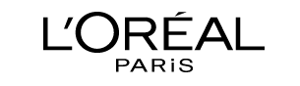
Step 1: define item features — feature engineering
Movie | Action | Runtime | Description word soup | ...
Movie 1 | 1 | 123 | jealousy toy boy tomhanks timallen donrickles ... | ...
Movie 2 | 0 | 96 | boardgame disappearance basedonchildren'sbook ... | ...
... | ... | ... | ... | ...
Notes:
Feature space different for products (lip stick vs foundation)
Can describe features using different systems (l’oreal vs estee lauder)
Potential solution: use unsupervised feature learning algorithm (same idea as word2vec)
Challenge for content-based
Most difficult part of content-based filtering is the feature engineering. For instance, if you have a movie description, director, cast, how do you use them all? Maybe you combine them into a single soup of words and then vectorize this using just the occurrence count or the TFIDF?
Often times the features to use aren’t obvious.
You will just have products and a ton of metadata about them.
Example: I was developing a recommender for the makeup company I worked at, and the biggest challenge was feature engineering.
Our databases had a ton of information for each product. Lipstick colour, amount of shine, foundation shade, etc.
But how do you bring many different products (e.g. lipsticks, eye-liners, foundations, skin products) into a single unified feature space?
Might think that we could have used a different feature space and recommender for each type of product, but since we were working with databases from multiple companies, individual product types didn’t even have the same database features.
It was a nightmare to work with the product features, and we just ended up using information about which products were purchased together to learn a feature space. Common approach, and we’ll see a use-case of it soon.
Big reason why collaborative filtering based methods, that don’t rely on any information about the products, are so popular.
Will have an activity soon to help us understand how designing features for content-based recommenders could be, and how you can get creative with it.

Slide 12
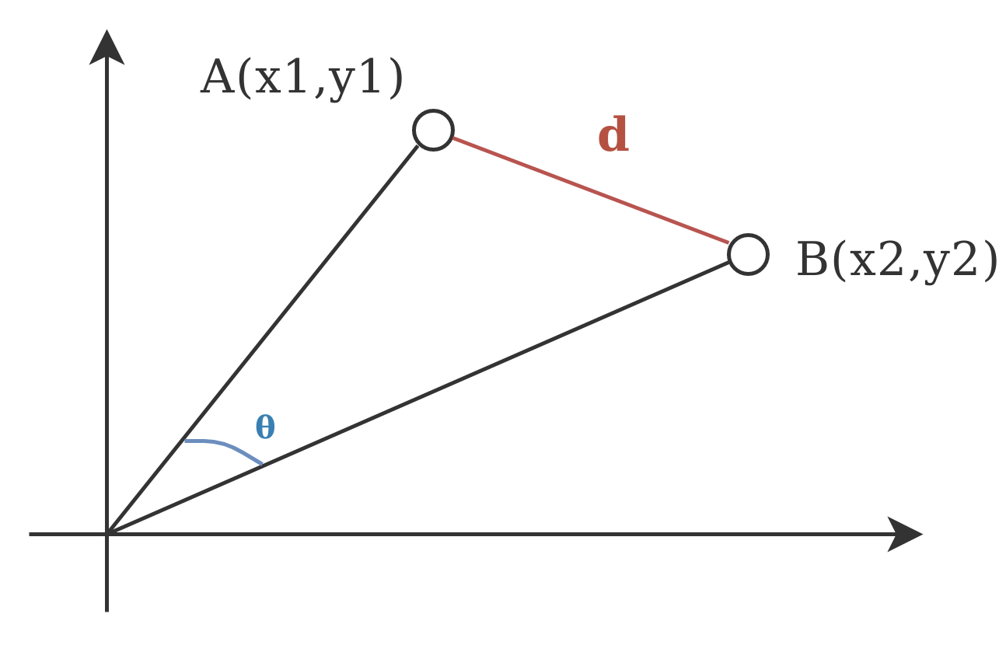
Step 2: define a distance metric
Euclidean distance
Geometric distance between two points
Considers magnitude and direction of vectors
Range: (0, ∞)
Interpretation: lower is more similar
def euclidean_distance(x, y):
return np.sqrt(np.sum((x - y) ** 2))
Cosine similarity
Angular distance between two points
Considers direction of vectors
Range: (-1, 1)
Interpretation: higher is more similar
def cosine_similarity(x, y):
return np.dot(x, y) / (np.sqrt(np.dot(x, x)) * np.sqrt(np.dot(y, y)))
Notes:
Use cosine when the magnitudes matter less than the ratios between features.
Example: Magnitudes in Bag of Words representations will be affected by length of the document, but the ratios between the words shouldn’t.
2D ex: “Action” and “comedy” on the axes.
Can use other distance metrics and tweak these (e.g. non-equal feature importance in euclidean distance).

Slide 13
Step 2: learn a distance metric?
Instead of picking a distance metric that may not work well for our feature space, we can also learn a distance metric. Called “distance metric learning”
Function that takes 2 sets of features and outputs a positive number
Has the potential to:
Learn relative feature importance
Account for feature interactions
Reduce the load on feature engineering
Challenges: how to train?
Comprehensive overview and technical tutorial
Item 1
Item 2
D(a, b)
d
Notes:
Could be a neural network (input=2 items and their features, output=distance).
E.g. Runtime is important when action, not for comedy
Relates to an unsupervised task called “contrastive learning” that has become very popular in deep learning, but contrastive learning is more effective on unstructured (raw) data like images.

Slide 14
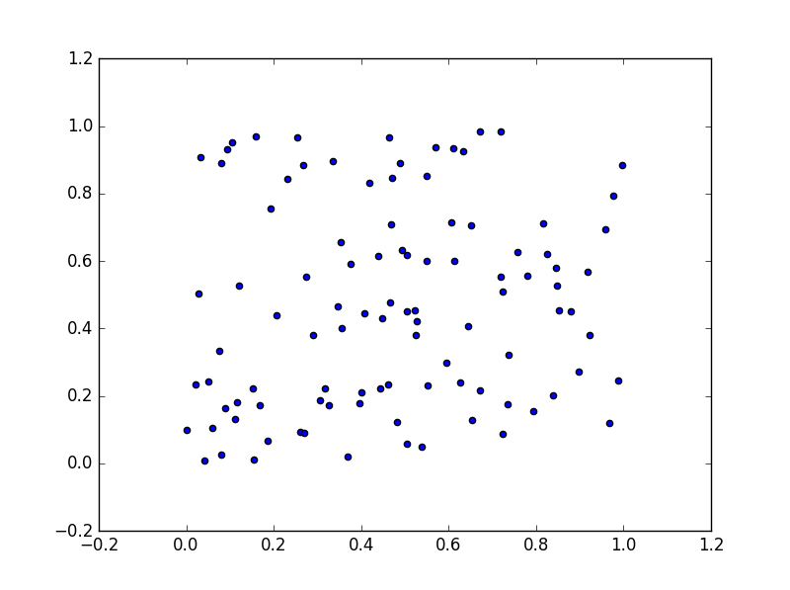
Step 3: recommend items
Based on the user’s items, (e.g. currently viewing, cart, history), recommend items with the highest similarity (i.e. lowest distance)
most similar
item
Feature 2
Feature 1
Notes:
Mention distance metrics here (euclidean vs cosine) and explain example.
How you recommend items based on these distances is totally up to you!
KNN
Everything within threshold
Clustering
etc.

Slide 15
Activity: movie feature engineering

Slide 16
Activity: movie feature engineering
Imagine you are a data scientist at Netflix trying to come up with movie features for a content-based recommender
Assume access to video, audio, dialogue, genre, description, twitter, etc.
In groups, come up with 1 or more features that you could use
What is the feature?
Why would this feature be useful? What relevant information would it carry?
How would you engineer (or learn) the feature from the raw data? (i.e. numeric representation)
What would be the challenges, if any?
10 minutes in groups, then verbally tell us your ideas
Notes:
Features must be numbers or vectors so that we can compute distances. Not allowed to say something like “my feature is the cast list!”. That’s the raw data. How would you represent information about the cast as a number or a vector?
Get creative! No boring and obvious features like “one-hot encode the genre”. Nothing that you could essentially just grab from a database; the point of the exercise is to think of features you could engineer.

Slide 17
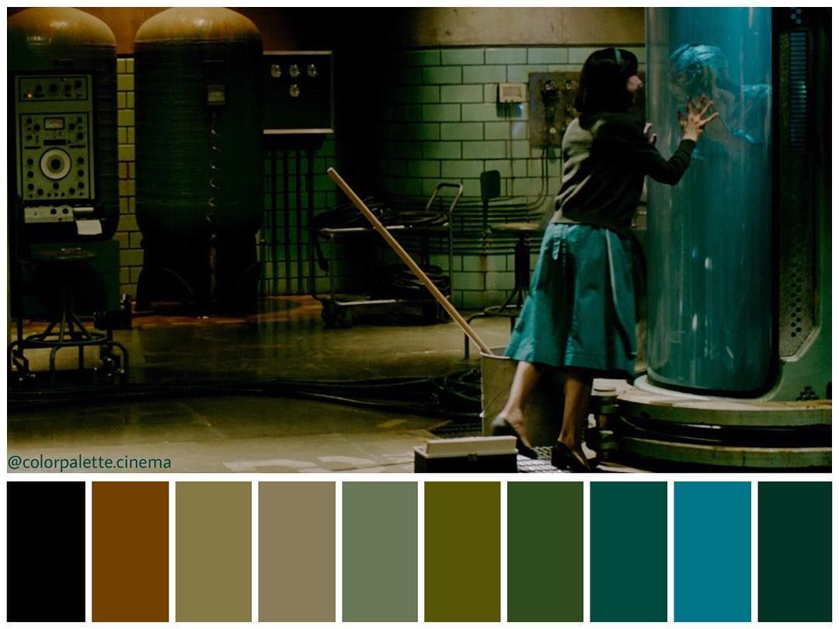
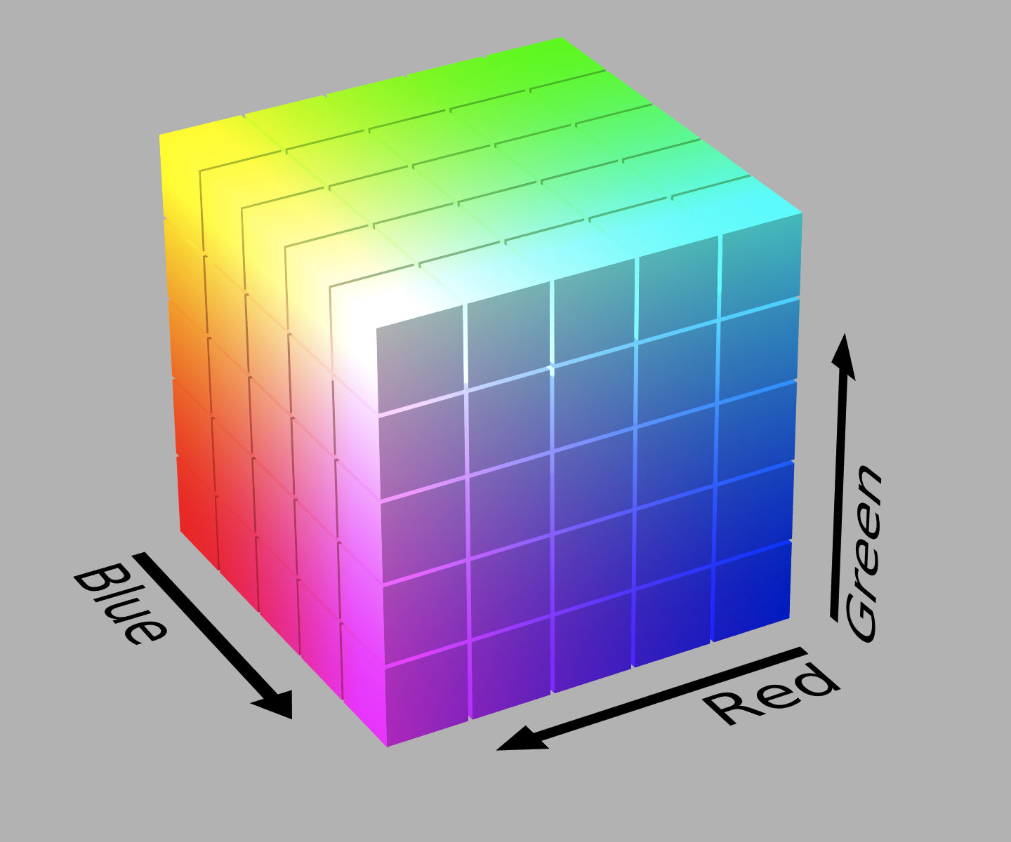
Example: colour palette
Notes:
My example:
Feature: Colour palette of the movie.
Utility: Movies have very different colour palettes. The palette carries information about the tone of the movie, the director, whether it has a lot of indoor scenes or outdoor scenes, whether it has daytime or nighttime scenes, etc.
Construction: 3D colour histogram of pixel values computed across all spatial dimensions and the temporal dimension . This would give a vector of numbers.
Challenges:
A 3D histogram has a lot of numbers. Solution: larger histogram bins.
A lot of frames, computationally expensive. Solution: just use the trailer.
Euclidean and cosine distance metric treat vector units as if they had no order. Here, there are spatial relationships between different colour bins (colours can be more/less similar). Solution: use a distance metric that takes into account spatial relationships between vector dimensions (e.g. Earth Mover’s Distance)

Slide 18
Case study:
co-occurrence feature engineering
Notes:
An unsupervised way to learn important features (using co-occurrence—things that appear in the same context).
I believe you guys learned this over the weekend under the name “market basket analysis”
Case study using word2vec to learn product features based on whether people purchase or look at products together frequently. Just like how word2vec learned word features based on how much words occurred in the same context.

Slide 19
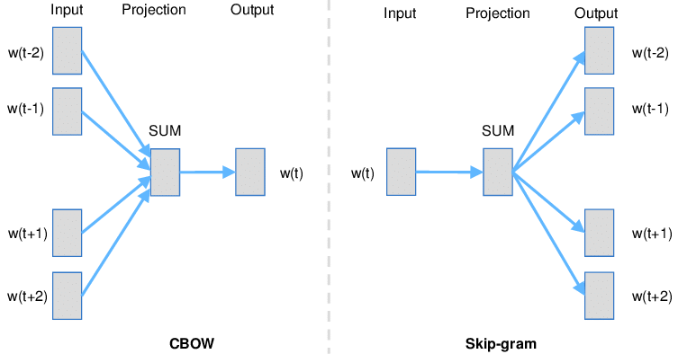
Word2Vec
Notes:
The encoding of a word is learned through an unsupervised task of trying to predict the other words around it (or the reverse task).
Using information about what words tend to co-occur together in order to learn feature representations of them.
Example: “the X jumped onto the table”
Cat? Child? TV?

Slide 20
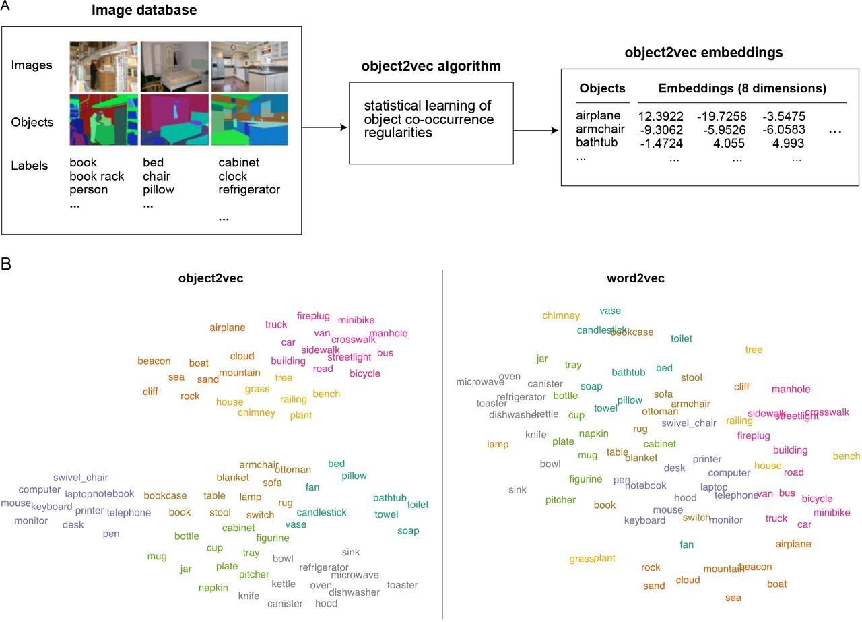
Word2Vec for arbitrary data
Notes:
Word2vec is a simple training method for encoding discrete items into vectors based on the context in which those items appear. What other items do they tend to appear with?
In language, this is very powerful. Meaning of a word seems to be related to the context it’s used, the words it appears with.
Object2vec encodes representations of objects based on whether or not they tend to appear together in the same scene images. My supervisor has found that these object embeddings are pretty similar to neural representations evoked when people look at objects, so maybe this is one way in which our own brain understands objects. Based on the contexts they appear in.

Slide 21
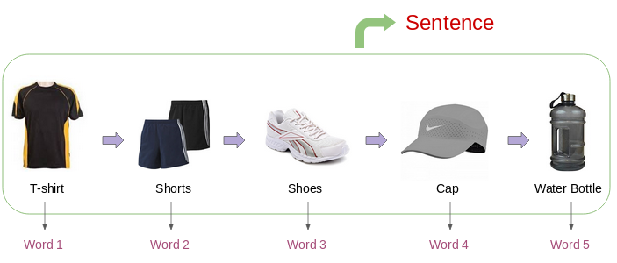
Word2Vec for content recommendation features
Notes:
People don’t always use word2vec to encode items in a feature space while avoiding feature engineering, but the general approach of using co-occurrence information (what people purchased together, the different items they clicked into after a search, etc.) is very popular as a way of getting unannotated similarity information to learn a feature space (or to learn a distance metric).

Slide 22
Demo

